Slide 1
Finding out the similarity between Toronto’s neighborhood and Cherryhill

Slide 2
Introduction
Cherryhill is a community in London, Ontario.
Cherryhill is the most popular renting choice for Western University’s students.
Most of those students will work in GTA area after they graduate and rent an apartment near their workplace.
Some of them want to find out a place that is similar to their old living place.

Slide 3
Data sources
The postcode, borough and neighborhood of Great Toronto’s Area can be found from Wikipedia (https://en.wikipedia.org/wiki/List_of_postal_codes_of_Canada:_M).
The latitude and the longitude of each postcode can be found from (http://cocl.us/Geospatial_data).
The postcode, borough, neighborhood, latitude and the longitude of Cherryhill can be find using google search.
The venues around each postcode can be found by requiring from Foursquare.

Slide 4
Data cleaning
Extracting columns ‘PoatalCode’, ‘Borough’ and ‘Neighborhood’ from original dataframe.
Ignoring cells with a borough that is ‘Not assigned’.
Combining rows with same postcode.
Renaming the neighborhood’s cell as borough’s name if the cell was ‘Not assigned’.
Merging the dataframe with another dataframe which contains latitude and the longitude of each postcode.
Extracting rows only have ‘Downtown Toronto’ and merge with Cherryhill’s dataframe.

Slide 5
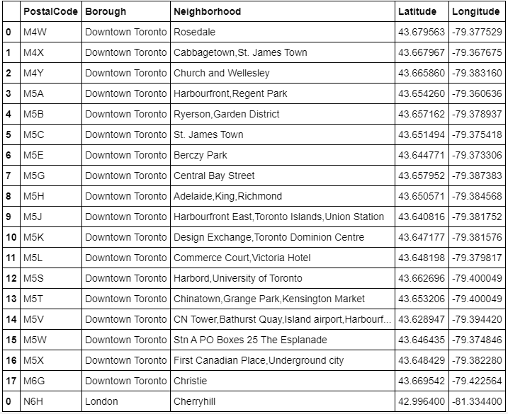
Table 1. Geomatic information of downtown Toronto and Cherryhill

Slide 6
Data cleaning
Requiring venue information around each postcode from Foursquare.
Converting venue’s category into dummy variable
Grouping rows by neighborhood and taking the mean of the frequency of occurrence of each category

Slide 7
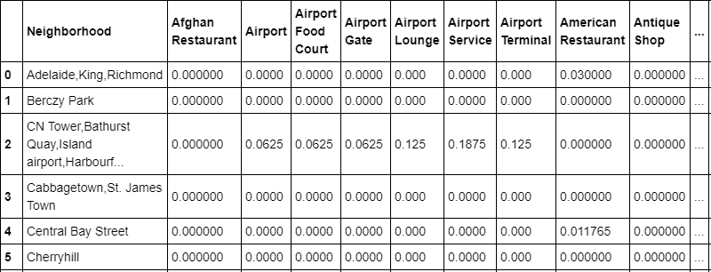
Table 2. Frequency of each category’s occurrence based on postal code

Slide 8
Calculation of similarity
Euclidean distance is used to calculate the similarity between Toronto’s neighborhood and Cherryhill.
The frequency of each category’s occurrence based on postal code is used as data.
Finally, finding out the area with lowest Euclidean distance.

Slide 9
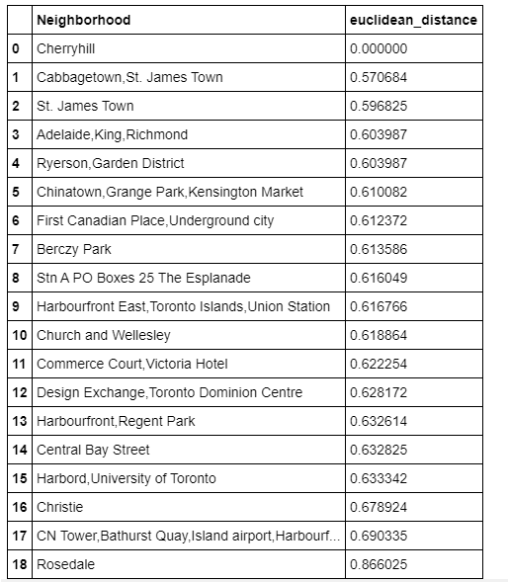
Table 3. Euclidean distance between Toronto’s neighborhood and Cherryhill
The neighborhood ‘Cabbagetown,St. James Town ' in downtown Toronto has the lowest Euclidean distance with Cherryhill.
Therefore, the neighborhood ‘Cabbagetown,St. James Town ' is the most similar area to Cherryhill among downtown Toronto.

Slide 10
Discussion
Although the neighborhood ‘Cabbagetown,St. James Town ' is the most similar area to Cherryhill among downtown Toronto, the Euclidean distance is 0.570684 which is not small enough.
Therefore, students who wants to find a similar living place in GTA should looking for other borough such as North York, Scarborough and Etobicoke.

Slide 11
Conclusion
People who wants to find out a similar living place in downtown Toronto to Cherryhill should choose neighborhood ‘Cabbagetown,St. James Town '.

